Slide 1
VERITASPULSE
VIA Visual Lock v1 — Closeout
Formalise the VIA design-DNA spec and close the VDF/VRN PanoramaFix 278-issue backlog across a 5-wave, risk-tiered plan.
VPL-DEMO-01 · Owner: Tony · 2026-05-01 → 2026-06-20 · 2026-05-31

Slide 2
Executive Snapshot
COMPLETION
TASKS DONE
BUDGET USED
OPEN RISKS
68%
4/8
77%
3
weighted avg
on track
$125k / $162k
active mitigations
MILESTONES
Visual Lock spec frozen
due 2026-05-31 · pending
PanoramaFix closeout (applied>0)
due 2026-06-04 · pending
Module Standard GA
due 2026-06-20 · pending

Slide 3
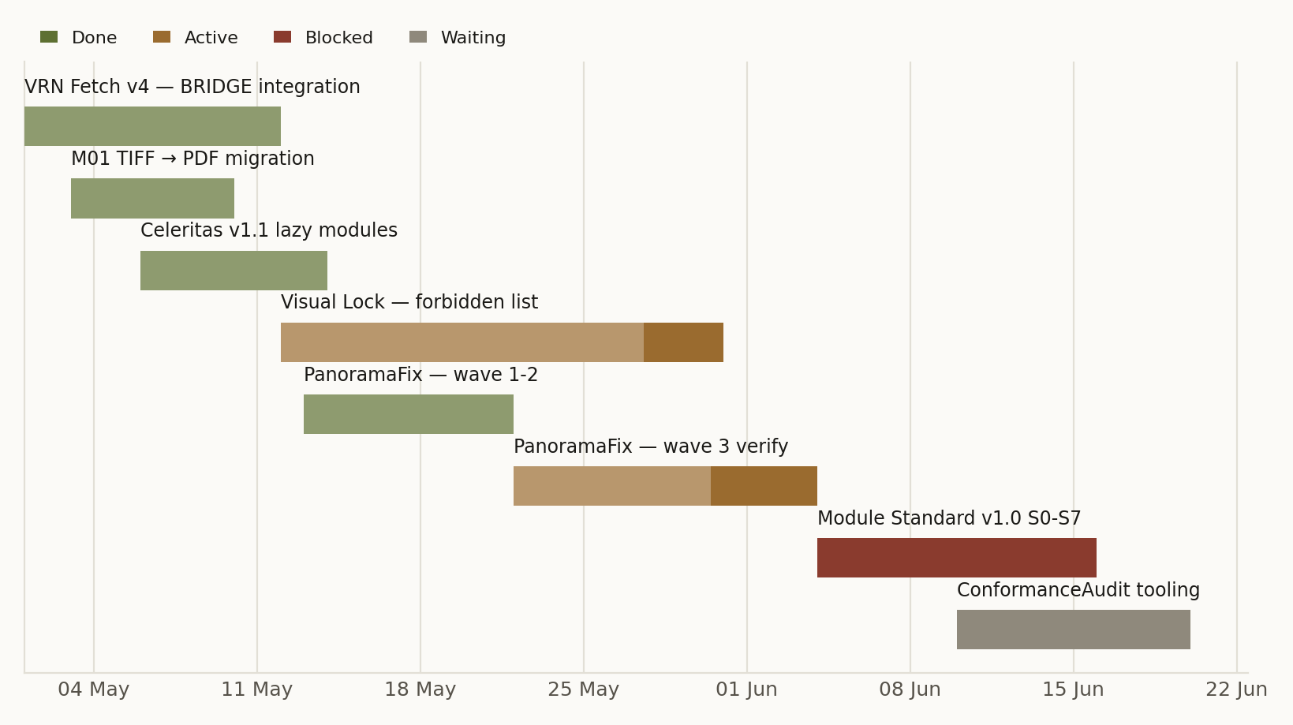
Timeline & Schedule
Gantt · status-coloured · progress overlay

Slide 4
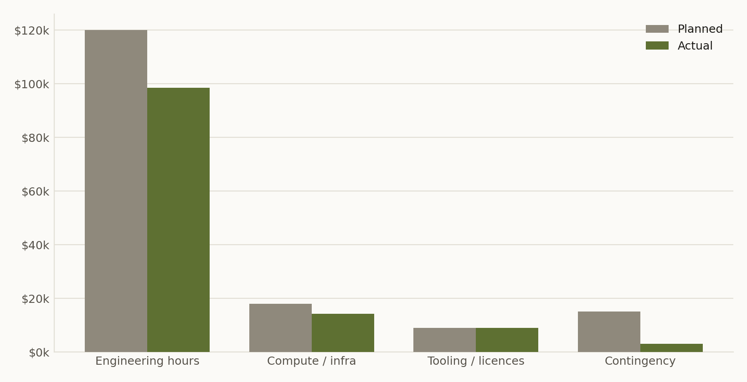
Budget
Planned vs Actual
VARIANCE
$+37k
Under budget
Spent $125k of $162k

Slide 5
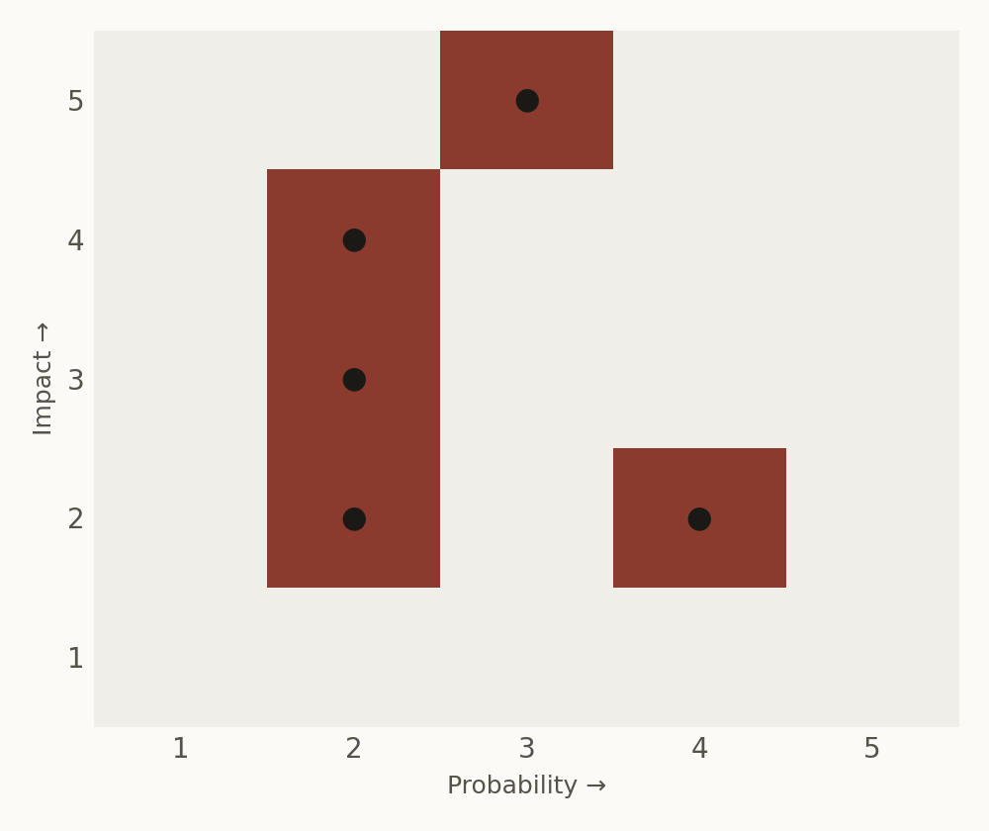
Risk & Crisis
Probability × Impact
TOP RISKS
● wave-3 patch fails applied>0 gate
P3×I5 = 15 · active
● numpy 2.0 leak into vpl_core
P2×I4 = 8 · active
● Font fallback breaks brand render
P4×I2 = 8 · active
● Seaborn/matplotlib pin drift
P2×I3 = 6 · watch

Slide 6
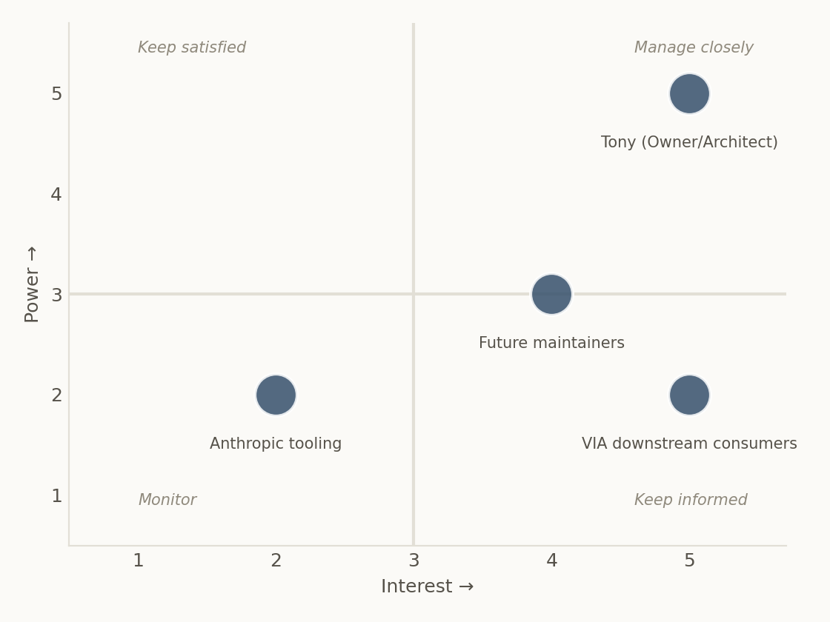
Stakeholders
Power / Interest matrix
ENGAGEMENT
● Tony (Owner/Architect)
Decision · P5/I5
● VIA downstream consumers
Affected · P2/I5
● Future maintainers
Affected · P3/I4
● Anthropic tooling
Support · P2/I2

Slide 7
Generated by VeritasPulse
VPL · Project & Time Intelligence · 2026-05-31 14:56

